Slide 1
An Open Interface for
Hooking Solvers to Modeling Systems
Robert Fourer, Jun Ma
Industrial Engineering & Management Sciences
Northwestern University
[4er,maj]@iems.northwestern.edu
Kipp Martin
Graduate School of Business
University of Chicago
kmartin@gsb.uchicago.edu
INFORMS International
Session TD08.3, July 10, 2007

Slide 2
An Open Interface for
Hooking Solvers to Modeling Systems
We describe a new open standard for representing optimization problem instances. At the heart of our proposal are OSiL, an XML-based representation for instances, and OSInstance, a corresponding in-memory representation. An open-source library, maintained as a COIN-OR project, provides application programming interfaces for reading and writing OSiL and OSInstance and for converting between them. Related representations handle the passing of options to solvers and the retrieval of results.

Slide 3
An Open Interface for
Hooking Solvers to Modeling Systems
Every optimization modeling system has developed its own way of representing problem instances. Hence each solver package for optimization problems must have a separate “driver” for every modeling system that it supports.
We describe a new open standard that, once adopted by modeling systems, will require each solver to have only one driver. The components of our proposal include OSiL, a new XML-based representation for optimization problem instances, and OSInstance, a corresponding in-memory representation. An open source library provides application programming interfaces for reading and writing OSiL and OSInstance and for converting between them. Related languages and libraries handle the passing of options to solvers and the retrieval of results, as well as protocols for facilitating solver registration, client and scheduler discovery, and communication between the various components of the optimization process.
This session will emphasize the practical aspects of using our tools to hook solvers to modeling systems, focusing on our overall Optimization Services framework (Ma), the modeling system interface to our library (Fourer), and the solver interface to our library (Martin).

Slide 4
Quick Overview
Modeler
Solver
OSiL, OSInstance
OSoL, OSOption
OSrL, OSResult
XML text files
  OSiL, OSoL, OSrL
In-memory data structures
  OSInstance, OSOption, OSResult

Slide 5
The Modeling System Interface
Motivation
  For any standard format
  For an XML-based format
Text files
  XML schema
  OSiL example
  Compression
  Extensions
In-memory data structures
  Objects and methods
  Writing a generator
  Translating from a modeling language

Slide 6
XML Means “Tagged” Text Files . . .
Motivation
Example: html for a popular home page
<html><head><meta http-equiv="content-type" content="text/html; charset=UTF-8"><title>Google</title><style><!--
body,td,a,p,.h{font-family:arial,sans-serif;}
.h{font-size: 20px;}
.q{text-decoration:none; color:#0000cc;}
//-->
</style>
</head><body bgcolor=#ffffff text=#000000 link=#0000cc vlink=#551a8b alink=#ff0000 onLoad=sf()><center><table border=0 cellspacing=0 cellpadding=0><tr><td><img src="/images/logo.gif" width=276 height=110 alt="Google"></td></tr></table><br>
.......
<font size=-2>&copy;2003 Google - Searching 3,307,998,701 web pages</font></p></center></body></html>
  . . . a collection of XML tags is designed for a special purpose
  . . . by use of a schema written itself in XML

Slide 7
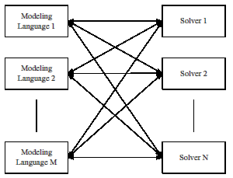
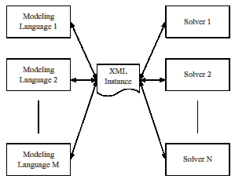
Advantage of any standard
Motivation
MN drivers
without a standard
M + N drivers
with a standard

Slide 8
Advantages of an XML Standard
Motivation
Specifying it
  Unambiguous definition via a schema
  Provision for keys and data typing
  Well-defined expansion to new name spaces
Working with it
  Parsing and validation via standard utilities
  Amenability to compression and encryption
  Transformation and display via XSLT style sheets
  Compatibility with web services

Slide 9
What about “MPS Form”?
Motivation
Weaknesses
  Standard only for LP and MIP, not for
  nonlinear, network, complementarity, logical, . . .
  Standard not uniform (especially for SP extension)
  Verbose ASCII form, with much repetition of names
  Limited precision for some numerical values
Used for
  Collections of (mostly anonymous) test problems
  Bug reports to solver vendors
Not used for
  Communication between modeling systems and solvers

Slide 10
Example: A Problem Instance (in AMPL)
Text files
ampl: display _varname, _var.lb, _var.init, _var.ub;
: _varname _var.lb _var.init _var.ub :=
1 "Trans['GARY','FRA']" 5 0 Infinity
2 "Trans['GARY','DET']" 5 0 Infinity
ampl: expand _obj;
minimize Obj:
(1 - x[0])^2 + 100*(x[1] - x[0]^2)^2 + 9*x[1];
ampl: expand _con;
subject to Con1:
10*x[0]^2 + 11*x[1]^2 + 3*x[0]*x[1] + x[0] <= 10;
subject to Con2:
log(x[0]*x[1]) + 7*x[0] + 5*x[1] >= 10;

Slide 11
Text from the OSiL Schema
Text files
<xs:complexType name="Variables">
<xs:sequence>
<xs:element name="var" type="Variable" maxOccurs="unbounded"/>
</xs:sequence>
<xs:attribute name="number" type="xs:positiveInteger" use="required"/>
</xs:complexType>
<xs:complexType name="Variable">
<xs:attribute name="name" type="xs:string" use="optional"/>
<xs:attribute name="init" type="xs:string" use="optional"/>
<xs:attribute name="type" use="optional" default="C">
<xs:simpleType>
<xs:restriction base="xs:string">
<xs:enumeration value="C"/>
<xs:enumeration value="B"/>
<xs:enumeration value="I"/>
<xs:enumeration value="S"/>
</xs:restriction>
</xs:simpleType>
</xs:attribute>
<xs:attribute name="lb" type="xs:double" use="optional" default="0"/>
<xs:attribute name="ub" type="xs:double" use="optional" default="INF"/>
</xs:complexType>

Slide 12
Example in OSiL
Text files
<instanceHeader>
<name>Modified Rosenbrock</name>
<source>Computing Journal3:175-184, 1960</source>
<description>Rosenbrock problem with constraints</description>
</instanceHeader>
<variables number="2">
<var lb="5" name="x0" type="C"/>
<var lb="5" name="x1" type="C"/>
</variables>
<objectives number="1">
<obj maxOrMin="min" name=“RError" numberOfObjCoef="1">
<coef idx="1">9</coef>
</obj>
</objectives>
<constraints number="2">
<con ub="10.0" name="Quad"/>
<con lb="10.0" name="LogQuad"/>
</constraints>

Slide 13
Example in OSiL (continued)
Text files
<linearConstraintCoefficients numberOfValues="3">
<start>
<el>0</el>
<el>1</el>
<el>3</el>
</start>
<rowIdx>
<el>0</el>
<el>1</el>
<el>1</el>
</rowIdx>
<value>
<el>1.0</el>
<el>7.0</el>
<el>5.0</el>
</value>
</linearConstraintCoefficients>
<quadraticCoefficients numberOfQPTerms="3">
<qpTerm idx="0" idxOne="0" idxTwo="0" coef="10"/>
<qpTerm idx="0" idxOne="1" idxTwo="1" coef="11"/>
<qpTerm idx="0" idxOne="0" idxTwo="1" coef="3"/>
</quadraticCoefficients>

Slide 14
Example in OSiL (continued)
Text files
<nl idx="-1">
<plus>
<power>
<minus>
<number type="real" value="1.0"/>
<variable coef="1.0" idx="1"/>
</minus>
<number type="real" value="2.0"/>
</power>
<times>
<power>
<minus>
<variable coef="1.0" idx="0"/>
<power>
<variable coef="1.0" idx="1"/>
<number type="real" value="2.0"/>
</power>
</minus>
<number type="real" value="2.0"/>
</power>
<number type="real" value="100"/>
</times>
</plus>
</nl>

Slide 15
Example in OSiL (continued)
Text files
<nl idx="1">
<ln>
<times>
<variable idx="0"/>
<variable idx="1"/>
</times>
</ln>
</nl>

Slide 16
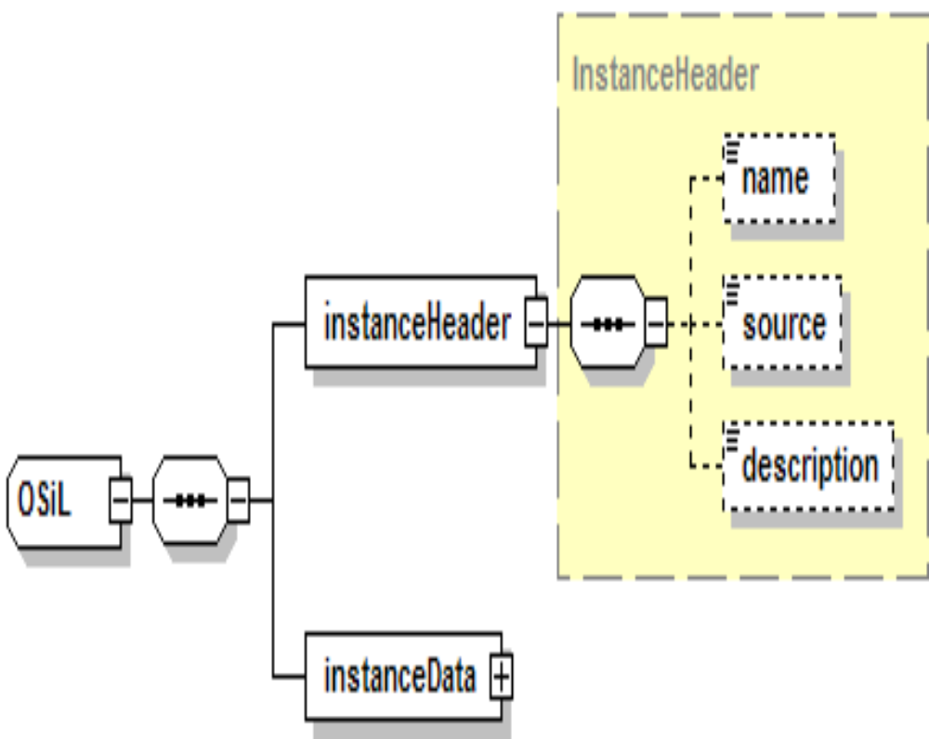
Diagram of the OSiL Schema
Text files

Slide 17
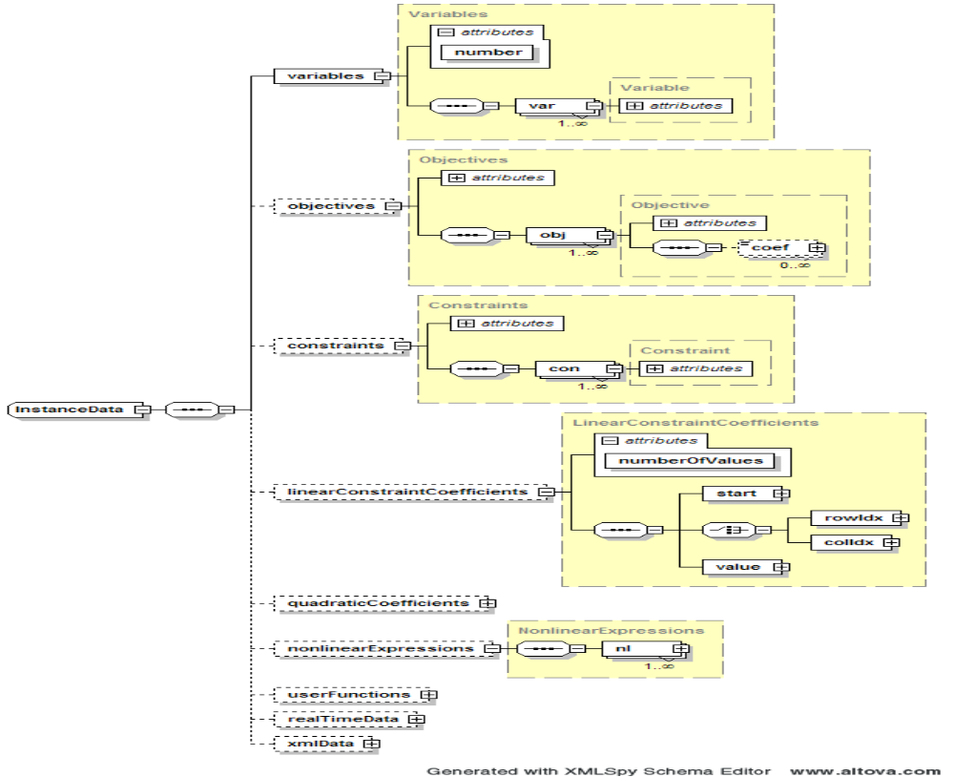
Details of OSiL’s instanceData Element
Text files

Slide 18
Details of OSiL’s instanceData Element
Text files

Slide 19
Compression
Text files
Specific to OSiL
  Collapse sequences of row/column numbers
  Collapse repeated element values
  Encode portions using base-64 datatype
General for XML
  Compression schemes designed for XML files
Comparisons
  XML base-64 < MPS
  XML with multiple values collapsed < 2 × MPS
  Compressed XML < Compressed MPS

Slide 20
Other Features in OSiL . . .
Text files
In current specification
  Real-time data
  Functions defined by the user
  Logical / combinatorial expressions (or, if, all-different)
In process of design
  Stochastic programming / optimization under uncertainty
  Complementarity constraints
  Semidefinite / cone programming

Slide 21
In-Memory Data Structures
OSInstance object class
  Parallels the OSiL schema
  complexType in schema ←→ class in OSInstance
  attributes / children of an element ←→ members of a class
  choices / sequences in the schema ←→ array members
OS expression tree
  Parallels the nonlinear part of the OSiL schema
  Designed to avoid lengthy “switch” statements
Creating an OSInstance
  Writing a generator
  Translating from AMPL
  . . . similar handling of OSOption, OSResult

Slide 22
Example
In-memory data structure
Schema complexType
<xs:complexType name="Variables">
<xs:sequence>
<xs:element name="var" type="Variable" maxOccurs="unbounded"/>
</xs:sequence>
<xs:attribute name="number" type="xs:positiveInteger" use="required"/>
</xs:complexType>
In-memory class
class Variables{
public;
Variables();
Variable *var;
int number;
}; // class Variables

Slide 23
Libraries (APIs, Interfaces)
In-memory data structure
Use by client
  OSInstance set() methods generate instance in memory
  OSiLWriter writes instance to a file in OSiL format
  Using SOAP over HTTP, instance is sent to a solver
Use by solver
  OSiLReader in solver interface
  reads instance from OSiL format back to memory
  OSInstance get() methods extract instance data
  as needed by solver
  Solver works on the problem
  Results are sent back similarly, using OSrL
  . . . OSiL can be skipped
  when instance is passed in memory

Slide 24
OSInstance Creation
Data Structures
Outline
#include "OSInstance.h"
#include "OSiLWriter.h"
#include "OSParameters.h"
#include "OSNlNode.h"
#include "LindoSolver.h"
#include <vector>
using namespace std;
int main(){
try{
OSInstance *osinstance;
osinstance = new OSInstance();
osinstance->setInstanceSource("LINDO samples directory");
osinstance->setInstanceDescription("Simple nonlinear");
...
}
catch(const ErrorClass& eclass){
cout << eclass.errormsg << endl;
}
}
Deprecated

Slide 25
OSInstance Creation (cont’d)
Data Structures
Variables
  addVariable(int index, string name, double lowerBound,
  double upperBound, char type, double init, string initString);
  addVariables(...)
osinstance->setVariableNumber(2);
osinstance->addVariable(0, "x0", -100, 100, 'C', OSNAN, "");
osinstance->addVariable(1, "x1", 0, 1, 'B', OSNAN, "");

Slide 26
OSInstance Creation (cont’d)
Data Structures
Objective
  bool addObjective(int index, string name,
  string maxOrMin, double constant, double weight,
  SparseVector* objectiveCoefficients);
osinstance->setObjectiveNumber(1);
SparseVector *objcoeff;
objcoeff = new SparseVector(1);
objcoeff->indexes = new int[1];
objcoeff->values = new double[1];
objcoeff->indexes[0] = 1;
objcoeff->values[0] = .4;
osinstance->addObjective
(-1, "objfunction", "max", 0.0, 1.0, objcoeff);

Slide 27
OSInstance Creation (cont’d)
Data Structures
Constraints
  bool addConstraint(int index, string name,
  double lowerBound, double upperBound, double constant);
  bool addConstraints(...)
osinstance->setConstraintNumber(6);
osinstance->addConstraint(0, "row0", -OSINFINITY, 4, 0);
osinstance->addConstraint(1, "row1", -OSINFINITY, 6, 0);
osinstance->addConstraint(2, "row2", -OSINFINITY, 0, 0);
osinstance->addConstraint(3, "row3", 0 , OSINFINITY, 0);
osinstance->addConstraint(4, "row4", -OSINFINITY, 0, 0);
osinstance->addConstraint(5, "row5", -OSINFINITY, 0, 0);

Slide 28
OSInstance Creation (cont’d)
Data Structures
Constraint coefficients
  bool setLinearConstraintCoefficients(int numberOfValues,
  bool isColumnMajor, double* values, int valuesBegin,
  int valuesEnd, int* indexes, int indexesBegin, int indexesEnd, int* starts, int startsBegin, int startsEnd);
double *values = new double[ 3];
int *indexes = new int[ 3];
int *starts = new int[ 3];
values[ 0] = 1.0;
values[ 1] = 1.0;
values[ 2] = 1.0;
indexes[ 0] = 0;
indexes[ 1] = 0;
indexes[ 2] = 1;
starts[ 0] = 0;
starts[ 1] = 2;
starts[ 2] = 3;
osinstance->setLinearConstraintCoefficients
(3, true, values, 0, 2, indexes, 0, 2, starts, 0, 2);

Slide 29
OSInstance Creation (cont’d)
Data Structures
Nonlinear expression setup
osinstance->instanceData
->nonlinearExpressions->numberOfNonlinearExpressions = 6;
osinstance->instanceData->nonlinearExpressions->nl = new Nl*[6];
OSnLNode *nlNodePoint;
OSnLNodeVariable *nlNodeVariablePoint;
OSnLNodeNumber *nlNodeNumberPoint;
OSnLNodeMax *nlNodeMaxPoint;
std::vector<OSnLNode*> nlNodeVec;

Slide 30
OSInstance Creation (cont’d)
Data Structures
generate cos(x₂+1) in constraint 3
osinstance->instanceData->nonlinearExpressions->nl[0] = new Nl();
osinstance->instanceData->nonlinearExpressions->nl[0]->idx = 3;
osinstance->instanceData->nonlinearExpressions->nl[0]
->osExpressionTree = new OSExpressionTree();
nlNodeVariablePoint = new OSnLNodeVariable();
nlNodeVariablePoint->idx=2;
nlNodeVec.push_back(nlNodeVariablePoint);
nlNodeNumberPoint = new OSnLNodeNumber();
nlNodeNumberPoint->value = 1.0;
nlNodeVec.push_back(nlNodeNumberPoint);
nlNodePoint = new OSnLNodePlus();
nlNodeVec.push_back(nlNodePoint);
nlNodePoint = new OSnLNodeCos();
nlNodeVec.push_back(nlNodePoint);
osinstance->instanceData->nonlinearExpressions->nl[ 0]
->osExpressionTree->m_treeRoot =
nlNodeVec[0]->createExpressionTreeFromPostfix(nlNodeVec);

Slide 31
OSInstance Use
Data Structures
Writing in OSiL for remote solution
OSiLWriter *osilwriter;
osilwriter = new OSiLWriter();
cout << osilwriter->writeOSiL(osinstance);
Solving locally in memory
LindoSolver *lindo;
lindo = new LindoSolver();
lindo->osinstance = osinstance;
lindo->solve();
cout << lindo->osrl << endl;

Slide 32
Translating from a Modeling Language
Data Structures
Sample model in AMPL
set ORIG; # origins
set DEST; # destinations
param supply {ORIG} >= 0; # amounts available at origins
param demand {DEST} >= 0; # amounts required at destinations
param vcost {ORIG,DEST} >= 0; # variable shipment costs per unit
param limit {ORIG,DEST} > 0; # limit on units shipped
var Trans {ORIG,DEST} >= 0; # units to ship
param fcost {ORIG} >= 0; # fixed costs for use of origins
var Use {ORIG} binary; # = 1 iff origin is used
minimize Total_Cost:
sum {i in ORIG, j in DEST}
vcost[i,j] * Trans[i,j] / (1 - Trans[i,j]/limit[i,j]) +
sum {i in ORIG} fcost[i] * Use[i];
subject to Supply {i in ORIG}:
sum {j in DEST} Trans[i,j] <= supply[i] * Use[i];
subject to Demand {j in DEST}:
sum {i in ORIG} Trans[i,j] = demand[j];

Slide 33
Translating from AMPL (cont’d)
Data Structures
AMPL session
ampl: model nltrans.mod;
ampl: data nltrans.dat;
ampl: option solver amplclient;
ampl: option amplclient_options "solver lindo";
ampl: option lindo_options "...";
ampl: solve;
LINDO 12.1
LOCALLY OPTIMAL SOLUTION FOUND ...
ampl: display Trans;
...

Slide 34
Translating from AMPL (cont’d)
Data Structures
OSiL derived from AMPL’s output format
<osil xmlns="os.optimizationservices.org" xmlns:xsi="http://www.w3.org/2001/XMLSchema-instance"
xsi:schemaLocation=
"os.optimizationservices.org ../schemas/OSiL.xsd">
<instanceHeader>
<description>Generated from AMPL nl file</description>
</instanceHeader>
<instanceData>
<variables numberOfVariables="24">
<var name="_svar[1]"/>
<var name="_svar[2]"/>
...
<var name="_svar[22]" type="B" ub="1"/>
<var name="_svar[23]" type="B" ub="1"/>
<var name="_svar[24]" type="B" ub="1"/>
</variables>
....
</instanceData>
</osil>

Slide 35
Translating from AMPL (cont’d)
Data Structures
OSiL derived from AMPL’s output format
<objectives numberOfObjectives="1">
<obj maxOrMin="min" numberOfObjCoef="24">
<coef idx="21">50000</coef>
<coef idx="22">3.94e+06</coef>
<coef idx="23">370000</coef>
</obj>
</objectives>
<constraints numberOfConstraints="10">
<con name="_scon[1]" ub="-0"/>
<con name="_scon[2]" ub="-0"/>
<con name="_scon[3]" ub="-0"/>
<con name="_scon[4]" lb="900" ub="900"/>
<con name="_scon[5]" lb="1200" ub="1200"/>
<con name="_scon[6]" lb="600" ub="600"/>
<con name="_scon[7]" lb="400" ub="400"/>
<con name="_scon[8]" lb="1700" ub="1700"/>
<con name="_scon[9]" lb="1100" ub="1100"/>
<con name="_scon[10]" lb="1000" ub="1000"/>
</constraints>

Slide 36
Translating from AMPL (cont’d)
Data Structures
OSiL derived from AMPL’s output format
<linearConstraintCoefficients numberOfValues="45">
<start>
<el>0</el>
<el>2</el>
<el>4</el>
...
</start>
<rowIdx>
<el>0</el>
<el>3</el>
<el>0</el>
<el>4</el>
<el>0</el>
<el>5</el>
...
</rowIdx>
<value>
<el>1</el>
...

Slide 37
Translating from AMPL (cont’d)
Data Structures
OSiL derived from AMPL’s output format
<linearConstraintCoefficients numberOfValues="45">
<start>
...
</start>
<rowIdx>
...
</rowIdx>
<value>
<el>1</el>
<el>1</el>
<el>1</el>
<el>1</el>
<el>1</el>
...
<el>-2800</el>
<el>-5200</el>
<el>-5800</el>
</value>
</linearConstraintCoefficients>

Slide 38
Translating from AMPL (cont’d)
Data Structures
OSiL derived from AMPL’s output format
<nonlinearExpressions numberOfNonlinearExpressions="1">
<nl idx="-1">
<sum>
<divide>
<times>
<number value="39" type="real"/>
<variable idx="0" coef="1"/>
</times>
<minus>
<number value="1" type="real"/>
<divide>
<variable idx="0" coef="1"/>
<number value="1300" type="real"/>
</divide>
</minus>
</divide>
...
</sum>
</nl>
</nonlinearExpressions>

Slide 39
Translating from AMPL (cont’d)
Data Structures
OSrL derived from solver’s results
<osrl xmlns:os="os.optimizationservices.org"
xmlns:xsi="http://www.w3.org/2001/XMLSchema-instance"
xsi:schemaLocation="os.optimizationservices.org
../schemas/OSiL.xsd">
<resultHeader>
<generalStatus type="success"/>
<serviceName>Solved using a LINDO service</serviceName>
</resultHeader>
<resultData>
<optimization numberOfSolutions="1" numberOfVariables="24"
numberOfConstraints="10" numberOfObjectives="1">
...
</optimization>
</resultData>
</osrl>

Slide 40
Translating from AMPL (cont’d)
Data Structures
OSrL derived from solver’s results
<solution objectiveIdx="-1">
<status type="optimal"/>
<variables>
<values>
<var idx="0">36.8552</var>
<var idx="1">563.142</var>
<var idx="2">122.355</var>
<var idx="3">0</var>
<var idx="4">991.065</var>
...
</values>
<other name="reduced costs">
<var idx="0">0</var>
<var idx="1">0</var>
<var idx="2">0</var>
<var idx="3">8.5573</var>
<var idx="4">-2.51902e-09</var>
...
</other>
</variables>

Slide 41
Translating from AMPL (cont’d)
Data Structures
OSrL derived from solver’s results
<objectives>
<values>
<obj idx="-1">722383</obj>
</values>
</objectives>
<constraints>
<dualValues>
<con idx="0">-12.4722</con>
<con idx="1">-98.9784</con>
<con idx="2">0</con>
<con idx="3">53.7812</con>
<con idx="4">35.7967</con>
<con idx="5">25.5129</con>
<con idx="6">17.9149</con>
<con idx="7">82.3857</con>
<con idx="8">193.978</con>
<con idx="9">29.3393</con>
</dualValues>
</constraints>
</solution>

Slide 42
For More Information
  R. Fourer, L.B. Lopes and K. Martin, LPFML: A W3C XML Schema for Linear and Integer Programming. INFORMS Journal on Computing 17 (2005) 139–158.
  R. Fourer, J. Ma and K. Martin, OSiL: An Instance Language for Optimization. www.optimization-online.org/DB_HTML/ 2006/03/1353.html.

